Slide 1
Chapter two
Uteroplacental circulation

Slide 2
Chapter outline
Introduction
Placenta
Fetal exposure to drugs used in obstetrics
Factors affecting uteroplacental blood flow
Summery

Slide 3
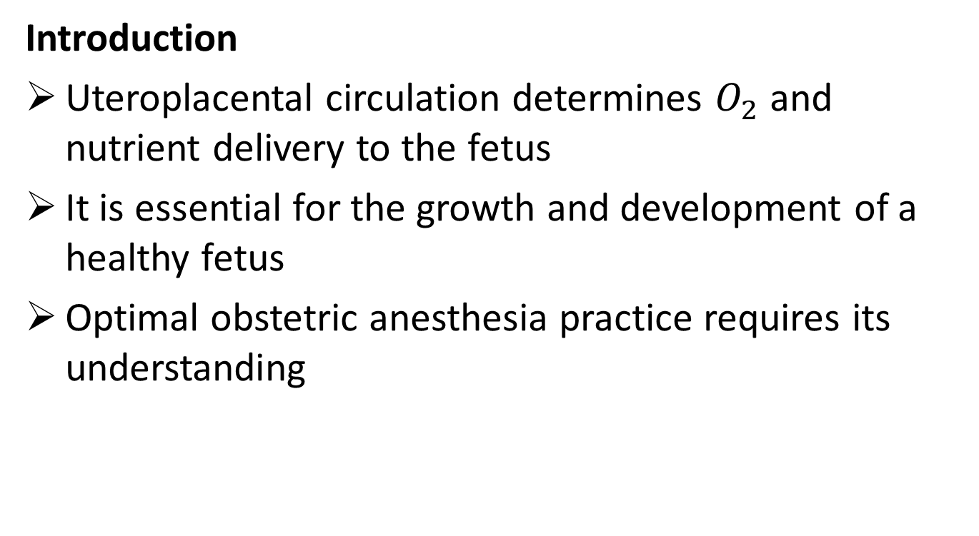
Uteroplacental circulation
Introduction
Uteroplacental circulation determines $O_{2}$ and nutrient delivery to the fetus
It is essential for the growth and development of a healthy fetus
Optimal obstetric anesthesia practice requires its understanding

Slide 4
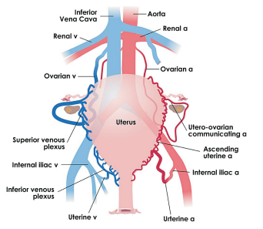
...cont’d
Uteroplacental perfusion originates from the uterine and ovarian arteries

Slide 5
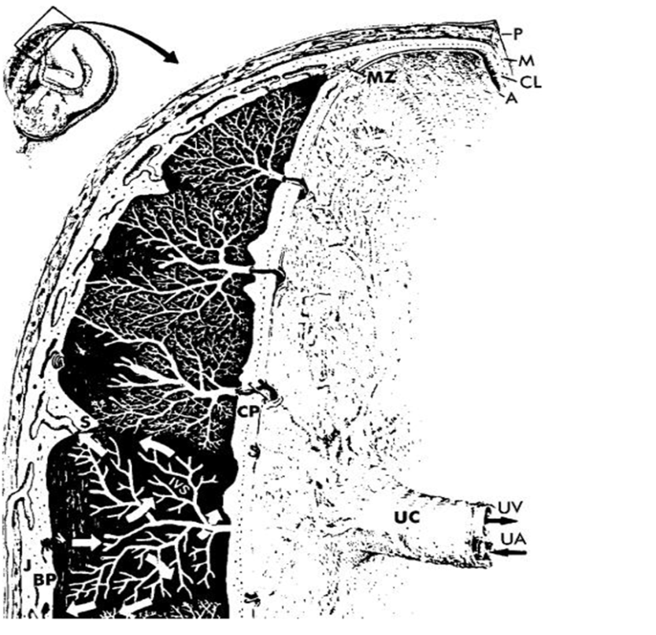
Introduction ...cont’d
Maternal blood enters into placenta through the basal plate
It passes into the veins of the basal plate and exits the uterus
Normally, the two circulations are separate, and there is no mixing

Slide 6
...cont’d
Uterine blood flow
 | Non pregnant | pregnant
Uterine blood flow | 50-100 ml/min | 700-900 ml/min
Percentage of CO | 5% | 10-12%

Slide 7
Placenta
Introduction
At implantation the developing blastocyst erodes the surrounding decidua
The throphoblasts secrete proteolytic enzymes that digest and liquefy the adjacent cells of the uterine endometrium

Slide 8
...cont’d
Once implantation has taken place, rapid proliferation of the throphoblast and uterine endometrium form placenta and various membranes
Placenta is a complex structure
It brings two circulations close together for the exchange of blood gases, nutrients, and wastes.

Slide 9

...cont’d
It is composed of basal and chorionic plate separated by intervillous space
The fetal capillaries with in villi readily exchange substances with the maternal blood

Slide 10
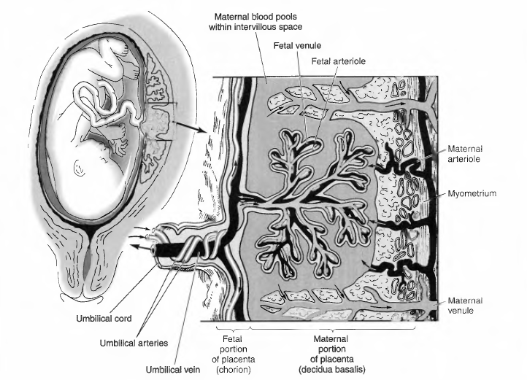
...cont’d
Maternal blood in the intervillous spaces is derived from spiral branches of the uterine artery and drains into the uterine veins.

Slide 11
...cont’d
Fetal blood within villi is derived from the two umbilical arteries and returns to the fetus via a single umbilical vein
Uterine blood flow
≈ 80% of passes through the intervillous space
≈20% goes to the myometrium
The placenta grows dramatically from the third month of gestation until term

Slide 12
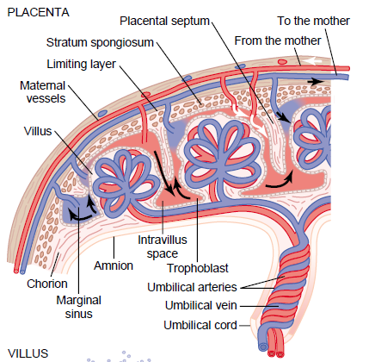
...Cont’d
By term, the mature placenta is:
Oval and flat,
An average diameter of 18.5 cm,
an average weight of 500 g,
an average thickness of 23 mm

Slide 13
Functions of placenta
Hormonal function
production of estrogen and progesterone
Production of enzymes, binding proteins, and polypeptide hormones
Produce proteins and steroid hormones →influence and control the fetal environment

Slide 14
Functions ...cont’d
Barrier function....imperfect barrier
cytochrome P-450 isoenzymes are found within the placenta
Binding some substances→ by specific or non specific binding within placental tissue
Diffusion may be influenced by membrane thickness

Slide 15
Transport mechanisms
Passive transport
Through lipid membranes or protein channels
Facilitated transport
Carrier-mediated transport of relatively lipid-insoluble molecules down their concentration gradient
Active transport
Against a concentration, electrical, or pressure gradient
Pinocytosis
Immunoglobulin G transfer from the maternal to the fetal circulation

Slide 16
Gas and nutrient transfer
Oxygen
Dissolved O2
Simple diffusion
Driven by O2 pressure
Factors
The hemoglobin of the fetus is mainly fetal hemoglobin
Oxyhemoglobin dissociation curve

Slide 17
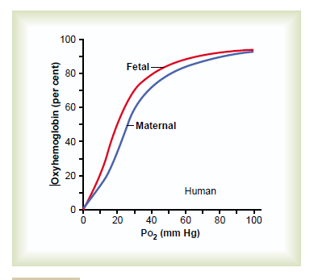
...cont’d
Oxyhemoglobin dissociation curve

Slide 18
...cont’d
Hemoglobin concentration difference
50 per cent greater than that of the mother
The Bohr effect
hemoglobin can carry more oxygen at a low PCO2 than it can at a high PCO2
More acidic maternal blood
More alkalotic fetal blood
Shift in the oxyhemoglobin dissociation curve

Slide 19
CO2 diffusion
The difference in PCO2
favors fetal-to-maternal transfer
Co2 is highly soluble in the placenta membrane
diffuse about 20 times as rapidly as oxygen.

Slide 20
...cont’d
Haldane effect within the maternal blood
The maternal-to-fetal transfer of oxygen → deoxyhemoglobin in the maternal blood → greater affinity for CO₂ than does oxyhemoglobin
It accounts for 46% of the transplacental transfer of CO2

Slide 21
...cont’d
Glucose
Facilitated diffusion by a d-glucose transport protein found with in the trophoblast membrane
At term, only 28% of the absorbed glucose is transferred to the umbilical vein
Aminoacids
Active process by linked carriers for both amino acids and sodium
Fatty acids
Simple diffusion

Slide 22
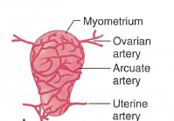
The maternal – placental- fetal unit Maternal component

Slide 23
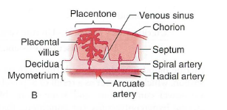
Placental component

Slide 24
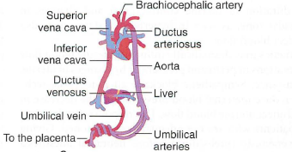
Fetal component

Slide 25
...cont’d
The fetal circulation is characterized by a parallel system
The placenta provides oxygenated blood into the ductus venosus, the inferior vena cava, and then into the right atrium
In the right atrium, the majority of the oxygenated blood flows through the foramen ovale
relatively low pressure in the left atrium
Some blood from the right atrium goes through the right ventricle and into the main pulmonary artery

Slide 26
...cont’d
The pulmonary vascular resistance is high in utero:
collapsed alveoli and compression of blood vessels
the relatively low P_{a}O₂ and pH of the blood that flow through the vessels
some blood in the pulmonary artery →pulmonary circulation → left atrium
But majority- ductus arteriosus → descending aorta

Slide 27
Fetal circulation
Umbilical vein | SVC
↓ ductus venosus | ↓
Inferior vena cava | Right atrium
↓ | ↓
Right atrium | Right ventricle
↓ foramen ovale | ↓
Left atrium | Pulmonary artery
↓ | ↓ductus arteriosus
Left ventricle | Descending aorta
↓ | ↓
Ascending aorta | Umbilical arteries

Slide 28
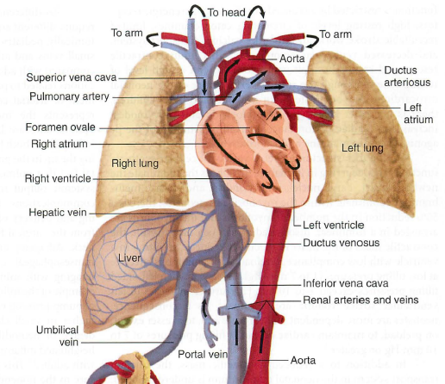
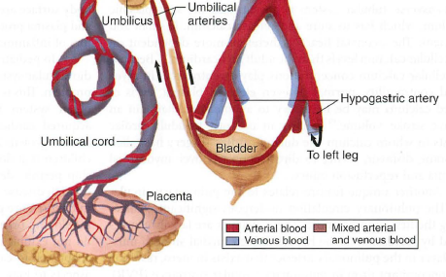

Slide 29
Fetal exposure to drugs used in obstetrics
Many drugs cross the placenta
Direct pharmacologic effect
Indirect effects on the intrauterine environment

Slide 30
...cont’d
Drugs cross the placenta by three main processes
Simple diffusion
Active transport
Pinocytosis

Slide 31
Fetal drug transfer
The extent of drug transfer is dependent on :
Molecular weight
Protein binding
Degree of lipid solubility
Maternal drug concentration
Maternal and fetal PH

Slide 32
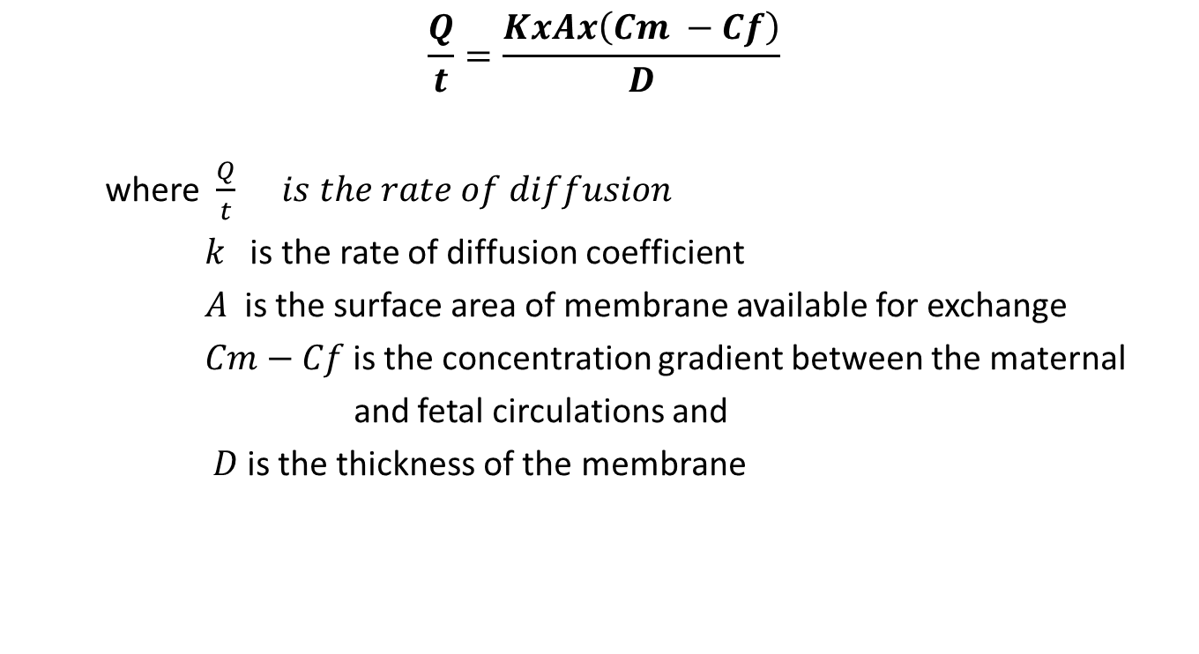
The Fick principle
$$\frac{Q}{t}=\frac{KxAx\left(Cm −Cf\right)}{D}$$
where $\frac{Q}{t} is the rate of diffusion$
$k$ is the rate of diffusion coefficient
$A$ is the surface area of membrane available for exchange
$Cm−Cf$is the concentration gradient between the maternal
and fetal circulations and
$D$is the thickness of the membrane

Slide 33
Placental transfer…cont’d
Pka of the drug
The Pka is the PH at which 50% of the drug is ionized and 50% unionized
Changes in maternal and fetal blood PH → affect ionization of a drug → placental transfer
A fetus with acidosis→ lower fetal PH favors ionization of basic local anesthetics (lidocaine ) →“ion trapping” in the fetus

Slide 34
...cont’d
Factors reducing fetal exposure to drugs
The fetal circulation
Dilution of umbilical venous blood
Hepatic drug uptake in the fetus

Slide 35
Factors affecting placental transfer of drug (maternal to fetus)
 | Increased transfer | Decreased transfer
Size-molecular weight(Da) | < 1000 | > 1000
Charge of molecule | Uncharged | Charged
Lipid solubility | Lipophilic | Hydrophilic
PH vs. drug pKa | Higher proportion of un-ionized drug in maternal plasma | Higher proportion of ionized drug in maternal plasma
Placental efflux transporter proteins(ex. P-glycoprotein) | Absent | Present
Binding protein type | Albumin (lower binding affinity) | Alpha-1-acid glycoprotein (AAG) (higher binding affinity)
Free (unbound drug fraction) | High | Low

Slide 36
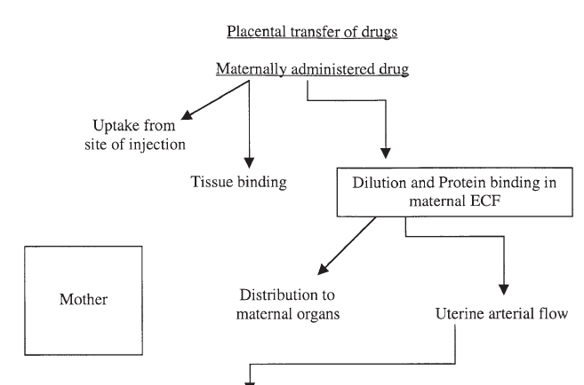
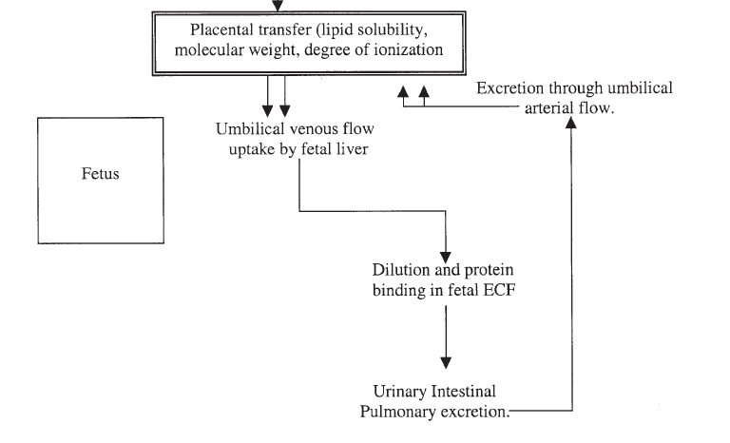

Slide 37
Placental transfer of anesthetic agents
Inhalational anesthetic agents
Lipid soluble
low molecular weight
Halothane is detectable in both umbilical venous blood and arterial blood within 1 minute
Both enflurane and isoflurane can cross the placenta rapidly

Slide 38
Inhalational agents...cont’d
Sevoflurane and desflurane → no report about placental transfer
Little fetal depression if
Limited doses(<MAC)
delivery occurs with in 10 minute of induction

Slide 39
Induction agents
Lipophilic → enhance transfer across the placenta
Barbiturates
The most commonly used induction agent, thiopental, can easily cross the placenta
Both maternal-to-fetal and fetal-to-maternal transfer of thiopental are strongly influenced by maternal and fetal protein concentration
Methohexital also crosses the placenta

Slide 40
Induction ...cont’d
Ketamine and propofol readily cross the placenta
limited fetal effects in usual induction doses
drug distribution,
metabolism
placental uptake
Benzodiazepines
Diazepam easily cross the placenta
highly unionized
lipophilic

Slide 41
...cont’d
Meperidine
Commonly used opioid in obstetrics
Can cause neonatal central nervous system (CNS) and respiratory depression
Intravenous administration →rapid transfer across the human placenta
The drug can be detected in umbilical venous blood as soon as 90 seconds after maternal administration

Slide 42
...cont’d
Morphine
rapidly crosses the placenta
It has more respiratory depressant effect in the new born than other opioids
Fentanyl
high level of lipophilicity
albumin binding
minimal neonatal effects unless (> 1µg/kg) are given immediately before delivery.

Slide 43
...cont’d
Alfentanyl
causes neonatal depression similar to meperidine
Remifentalyl
readily crosses the placenta and
It can produce respiratory depression in newborns

Slide 44
...cont’d
Local anesthetics → readily crosses the placenta
Muscle relaxants
Highly ionized → do not readily cross the placenta
Nondepolarizing muscle relaxants - low transfer rate
Succinylcholine
A single induction dose of is not detected in umbilical venous blood at delivery
Maternal doses larger than 300 mg are required before the drug can be detected in umbilical venous blood
High and repeated doses →neonatal neuromuscular blockade

Slide 45
…cont’d
Anticholinergic agents
Atropine and scopolamine cross the placenta
Glycopyrrolate is poorly transferred across the placenta
Anticholinesterase agents
Neostigmine, pyridostigmine and edrophonium → ionized at physiologic PH → limited transplacental transfer

Slide 46
...cont’d
Others
Most commonly used anesthetic adjuvants →readily cross the placenta.
Maternally administered drugs transferable to the fetus
Ephedrine
β-adrenergic blockers such as labetalol and esmolol
Vasodilators
Phenothiazine
Antihistamines (H1 and H2) and metoclopramide

Slide 47
Commonly used drugs that cross the placenta
Anticholinergic agents
atropine, scopolamine
Antihypertensive agents
beta-adrenergic receptor antagonists, nitroprusside, nitroglycerin
Benzodiazepines
diazepam, midazolam

Slide 48
...cont’d
Induction agents
propofol, thiopental
Inhalational anesthetic agents
halothane, isoflurane, nitrous oxide
Local anesthetics, opioids and vasopressors(ephedrine)

Slide 49
Insignificant transfer
Drugs that do not cross the placenta
Anticholinergic agents – glycopyrrolate
Anticoagulants – heparin
Insignificant or very small amount transfer
Muscle relaxants : -
depolarizing – succinylcholine
Nondepolarizing agents

Slide 50
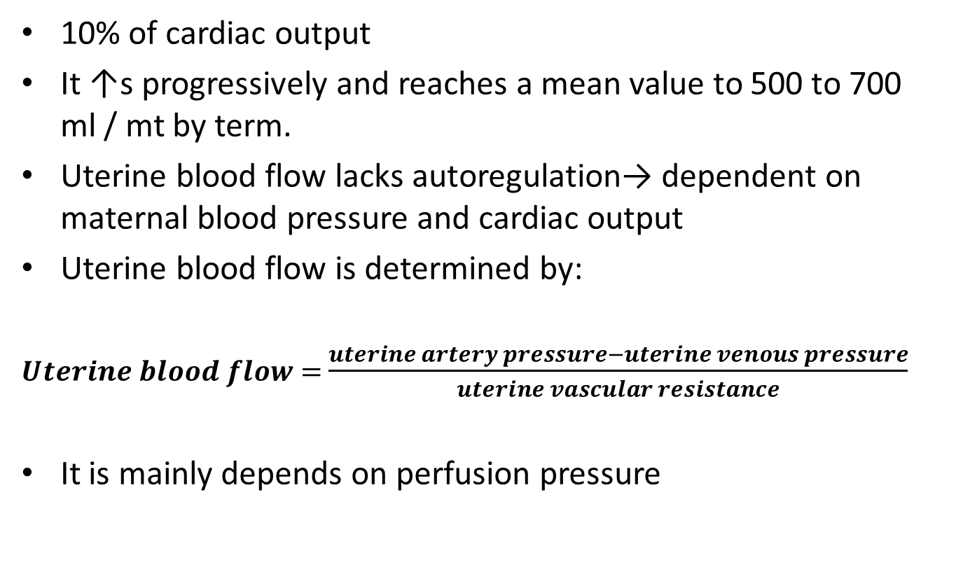
Uterine blood flow
10% of cardiac output
It ↑s progressively and reaches a mean value to 500 to 700 ml / mt by term.
Uterine blood flow lacks autoregulation→ dependent on maternal blood pressure and cardiac output
Uterine blood flow is determined by:
$Uterine blood flow=$ $\frac{uterine artery pressure−uterine venous pressure}{uterine vascular resistance}$
It is mainly depends on perfusion pressure

Slide 51
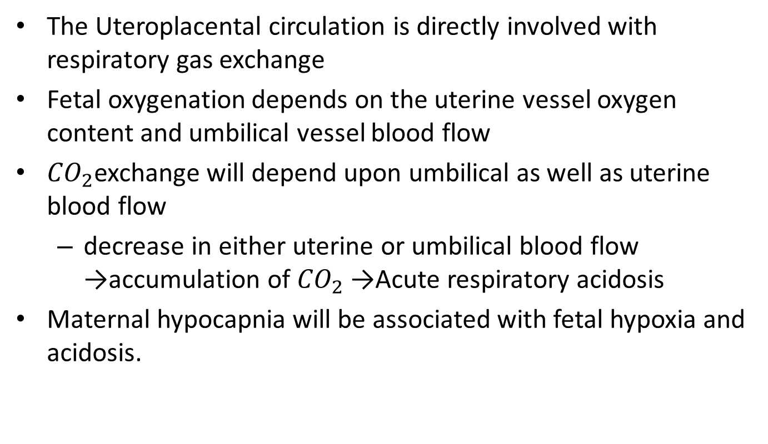
...cont’d
The Uteroplacental circulation is directly involved with respiratory gas exchange
Fetal oxygenation depends on the uterine vessel oxygen content and umbilical vessel blood flow
${CO}_{2}$exchange will depend upon umbilical as well as uterine blood flow
decrease in either uterine or umbilical blood flow →accumulation of ${CO}_{2}$ →Acute respiratory acidosis
Maternal hypocapnia will be associated with fetal hypoxia and acidosis.

Slide 52
Factors that can alter uteroplacental blood flow
Factors that decrease uterine blood flow
Uterine contraction – It reduces placental blood flow-
Decreased uterine blood flow
↓ed maternal MAP ↓uterine artery blood flow ↓uteroplacental blood flow
Aortocaval compression
Sympathectomy from regional anesthesia
Hypovolumia from severe shock

Slide 53
...Cont’d
c. Pathologic conditions
Pregnancy induced hypertension(preeclampsia)
d. Pharmacologic agents
Intravenous induction agents
Thiapental, methohexital
It reduces placental blood flow by 35%.....release of catecholamine due to light anesthesia

Slide 54
...cont’d
Diazepam
Has no effect in a dose of 0.5 mg/kg
Large doses ↓uteroplacental blood flow by ↓maternal MAP
Midazolam has the same effect.
Ketamine
Clinical doss of 1 mg/kg has no effect
Etomidate , propofol
A large drop in uterine blood flow with propofol than etomidate due to a ↓MAP

Slide 55
Inhalational agents
Halothane
1 MAC maintains uteroplacental blood flow by uterine vasodilation
A deep level of anesthesia (2 MAC) significantly reduce utero placental blood flow by ↓ing the maternal MAP
Isoflurane
Animal study with isoflurane have shown similar results as those with halothane.

Slide 56
...cont’d
Methoxyflurane
Less uterine relaxation
In high concentrations it ↓s uteroplacental blood flow -↓ maternal arterial pressure
Do not ↑uteroplacental blood flow even when administered in low concentrations

Slide 57
...cont’d
Enflurane
Light and moderate degree of anesthesia has no effect
Enflurane in concentration of more than 1 vol % produced :
dose related maternal and fetal bradycardia
decreased uteroplacental blood flow
fetal acidosis.

Slide 58
Desflurane and sevoflurane
A more precise control over maintenance of anesthesia and more rapid recovery is possible
Since these agents would be used only for a short time and in low concentrations in obstetrics anesthesia→ insignificant cardiovascular, respiratory, or hepatorenal problems

Slide 59
Local anesthetics
Lidocaine and mepivacaine
Can cause fetal bradycardia:
Uterine vasoconstriction due to large amounts of local anesthesia
Direct depression of the fetal heart by local anesthetics
At blood level 2 to 4 µg/ml , no significant reduction in uterine blood flow was observed

Slide 60
...cont’d
Ropivacaine and bupivacaine
In therapeutic doses
Do not cause vasoconstriction or
Do not reduce uteroplacental blood flow
Cocaine
It is associated with
significantly higher degree of uterine vasoconstriction
reduced utero placental blood flow

Slide 61
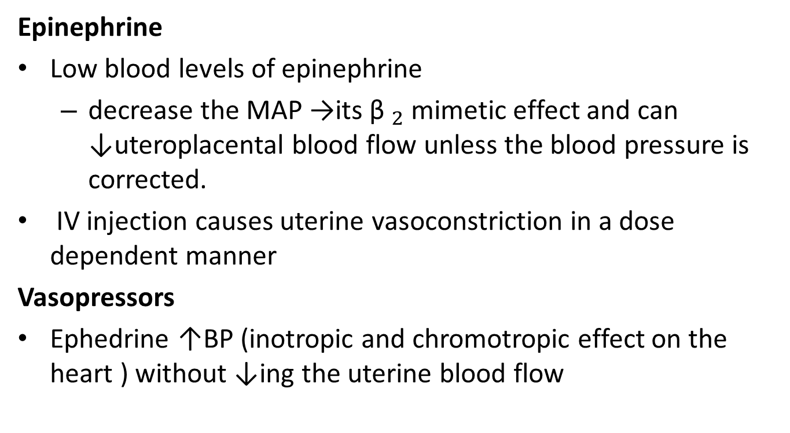
Pharmacologic agent added to the local anesthetics
Epinephrine
Low blood levels of epinephrine
decrease the MAP →its β$_{2}$ mimetic effect and can ↓uteroplacental blood flow unless the blood pressure is corrected.
IV injection causes uterine vasoconstriction in a dose dependent manner
Vasopressors
Ephedrine ↑BP (inotropic and chromotropic effect on the heart ) without ↓ing the uterine blood flow

Slide 62
…cont’d
Vasopressors which have mainly α – mimetic effects( mepheternime, metaraminol, methoxamine) ↑BP with a significant ↓in uterine blood flow
Phenylephrine, when used in small incremental doses, corrects the ↓ in maternal BP with out affecting the acid base values of neonates

Slide 63
Antihypertensive agents
Hydralazine
In animal studies, hydralazine ↓maternal BP with an associated ↑ in uteroplacental blood flow
There is no increase in intervillous blood flow in preeclampsia
Nitroglycerin
In animal study ,it ↓maternal BP(hypertensive) and caused an ↑ in uteroplaental blood flow.
Nitroprusside, trimethaphan (arfonad) and verapamil [in animal study]
reducing maternal artery BP → ↓ uteroplacental blood flow

Slide 64
Β-adrenergic blocking drugs
Propranolol(Inderal)
used in the treatment of :
pregnancy-induced hypertension
Thyrotoxicosis
idiopathic hypertrophic obstructive cardiomyopathy and
supraventricular tachycardia

Slide 65
Effect of propranolol in fetus
Bradycardia
Hypoglycemia
Intrauterine growth retardation
respiratory depression and
Hyperbilirubinemia
Esmolol
Because of rapid placental transfer , esmolol can cause direct fetal bradycardia.

Slide 66
Tocolytic drugs
Includes :
magnesium sulphate
β mimetic
calcium channel blockers
prostaglandin inhibitors
Uteroplacental blood flow will depend ultimately on the maternal MAP
If maternal MAP is maintained at a normal level, it can ↑Uteroplacental blood flow

Slide 67
…cont’d
Epidural and subarachnoid opiates
Epidural and subarachnoid opiates, except meperidine, do not affect the uteroplacental blood flow

Slide 68
Summery Causes of decreased uterine blood flow
Decreased perfusion pressure
Decreased uterine artery pressure
Supine position (aortocavel compression)
Hemorrhage / hypovolemia
Drug induced hypotension
Hypotension during sympathetic blockade

Slide 69
...cont’d
Increased uterine venous pressure
Venacaval compression
Uterine contractions
Drug- induced uterine hypertonus ( oxytocin, local anesthetics)
Skeletal muscle hypertonus ( seizure, valsalva)

Slide 70
…Cont’d
Increased uterine vascular resistance
Endogenous vasoconstrictors
Catecholamines ( stress)
Vasopressin (in response to hypovolemia)
Exogenous vasoconstrictors
Epinephrine
Vasopressors ( phenylephrine > ephedrine )
Local anesthetics ( in high concentrations )

Slide 71
Conclusion
Different anesthetic techniques and agents will affect uteroplacental blood flow and ultimately fetal well being. Hence appropriate knowledge of uteroplacental physiology and pathology is important for anesthetists

